Slide 1

Retail Sales Analysis
Description:
For the Analysis, major four steps had performed i.e. Data Extraction, data cleaning, Visualization of 4 question given in task and Insights.
Dataset Used:
Online Retail excel file, it contain 8 columns InvoiceNo, StockCode, Description, InvoiceDate, Quantity, UnitPrice, CustomerId, Country.
Tool used:
Power BI, power query, measures
Shinee Singh| 21-03-2025

Slide 2
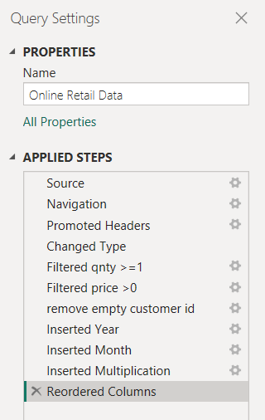

Data Extraction & data cleaning
Data Extraction :
To begin, I extracted online Retail data Excel files, I imported these datasets into Power BI using the Get Data feature, selecting the Excel connector. I then loaded the data into Power Query for preprocessing.
Data Cleaning : In Power Query, I addressed key data quality issues:
Create a check that the quantity should not be below 1 unit.
Create a check that the Unit price should not be below $0
Remove Empty values from the CustomerId field.
After cleaning, I loaded the transformed data into Power BI for visualization.

Slide 3
Data Transformation & Metrics
New Columns Created:
- Revenue: using the column quantity and UnitPrice.
Formula created : revenue = quantity * UnitPrice.
Key Metrics (DAX Measures in Power BI):
- Total Revenue: TotalRevenue = SUM('Online Retail Data'[Revenue])
Here, online retail data is the table name, revenue is the column and sum() function is used to total the revenue.

Slide 4
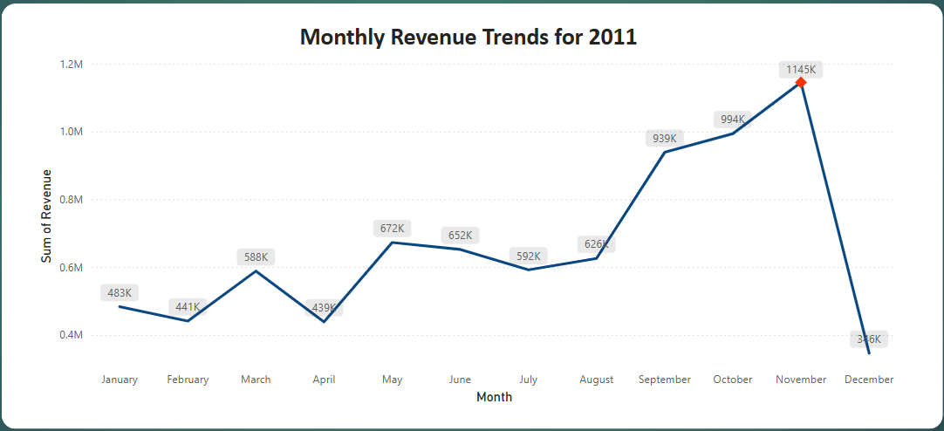
Monthly Revenue Analysis
Highest Revenue in November(1145k)
Lowest Revenue in December(376k)
Insight:
revenue fluctuation throughout the year.
April has lowest revenue points.
From may significant rise begins and continues upward.
Peak revenue in November due to seasonal demand.
Sharp drop in December due to post-holiday drop.

Slide 5
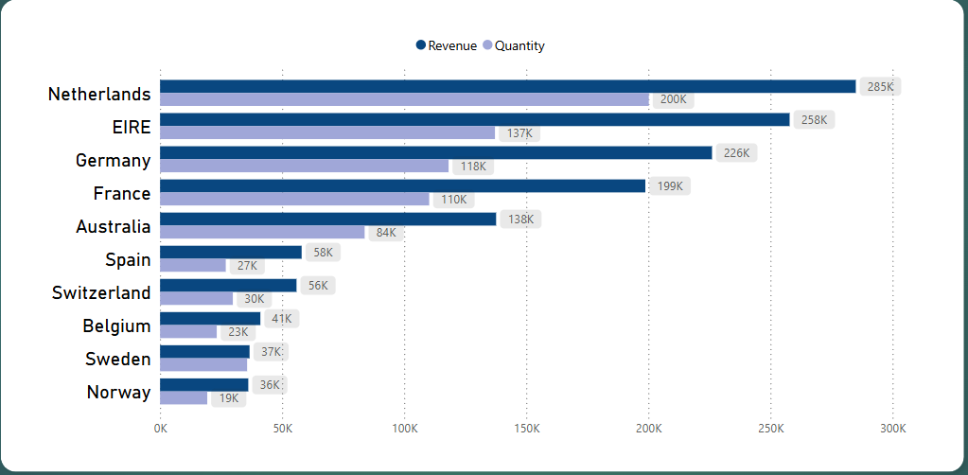
Top 10 Countries by Revenue
Top Revenue contributor:
Netherlands
Strong performer:
EIRE, Germany, France
Lower performer:
Sweden, Norway.

Slide 6
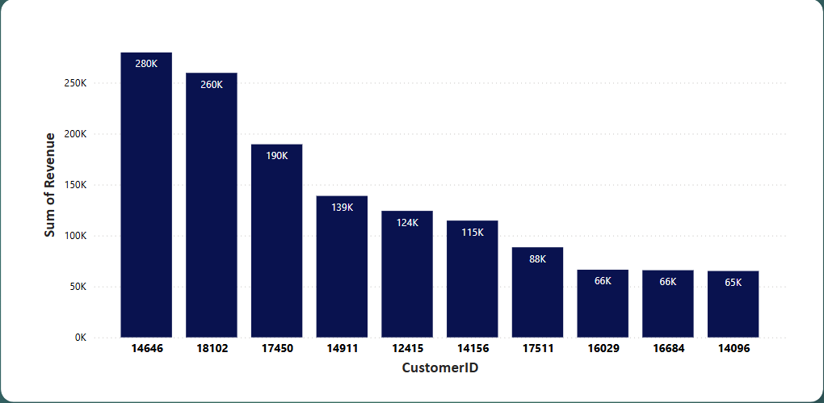
Top 10 Customer by Revenue
greatest revenue generating customer
(280k)

Slide 7
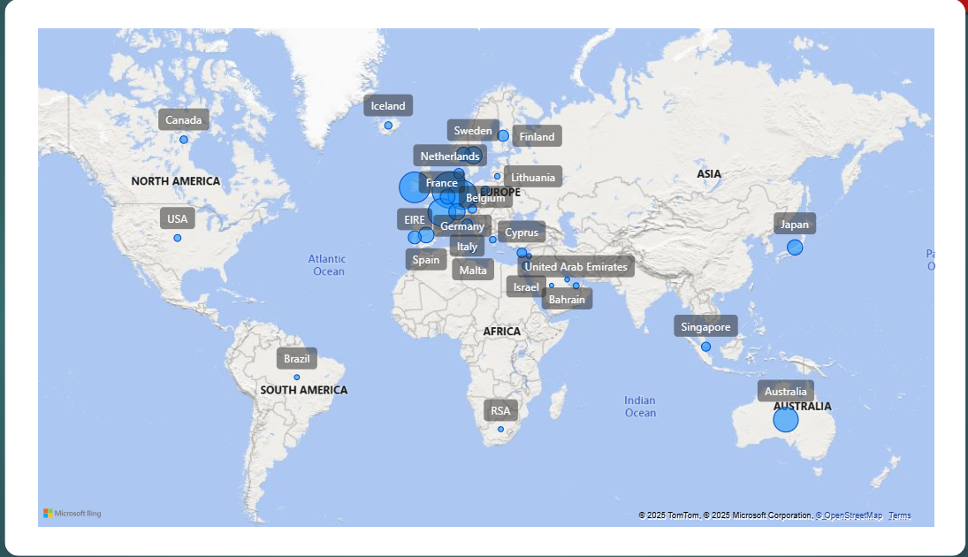
Regions with High Product Demand

